Slide 1

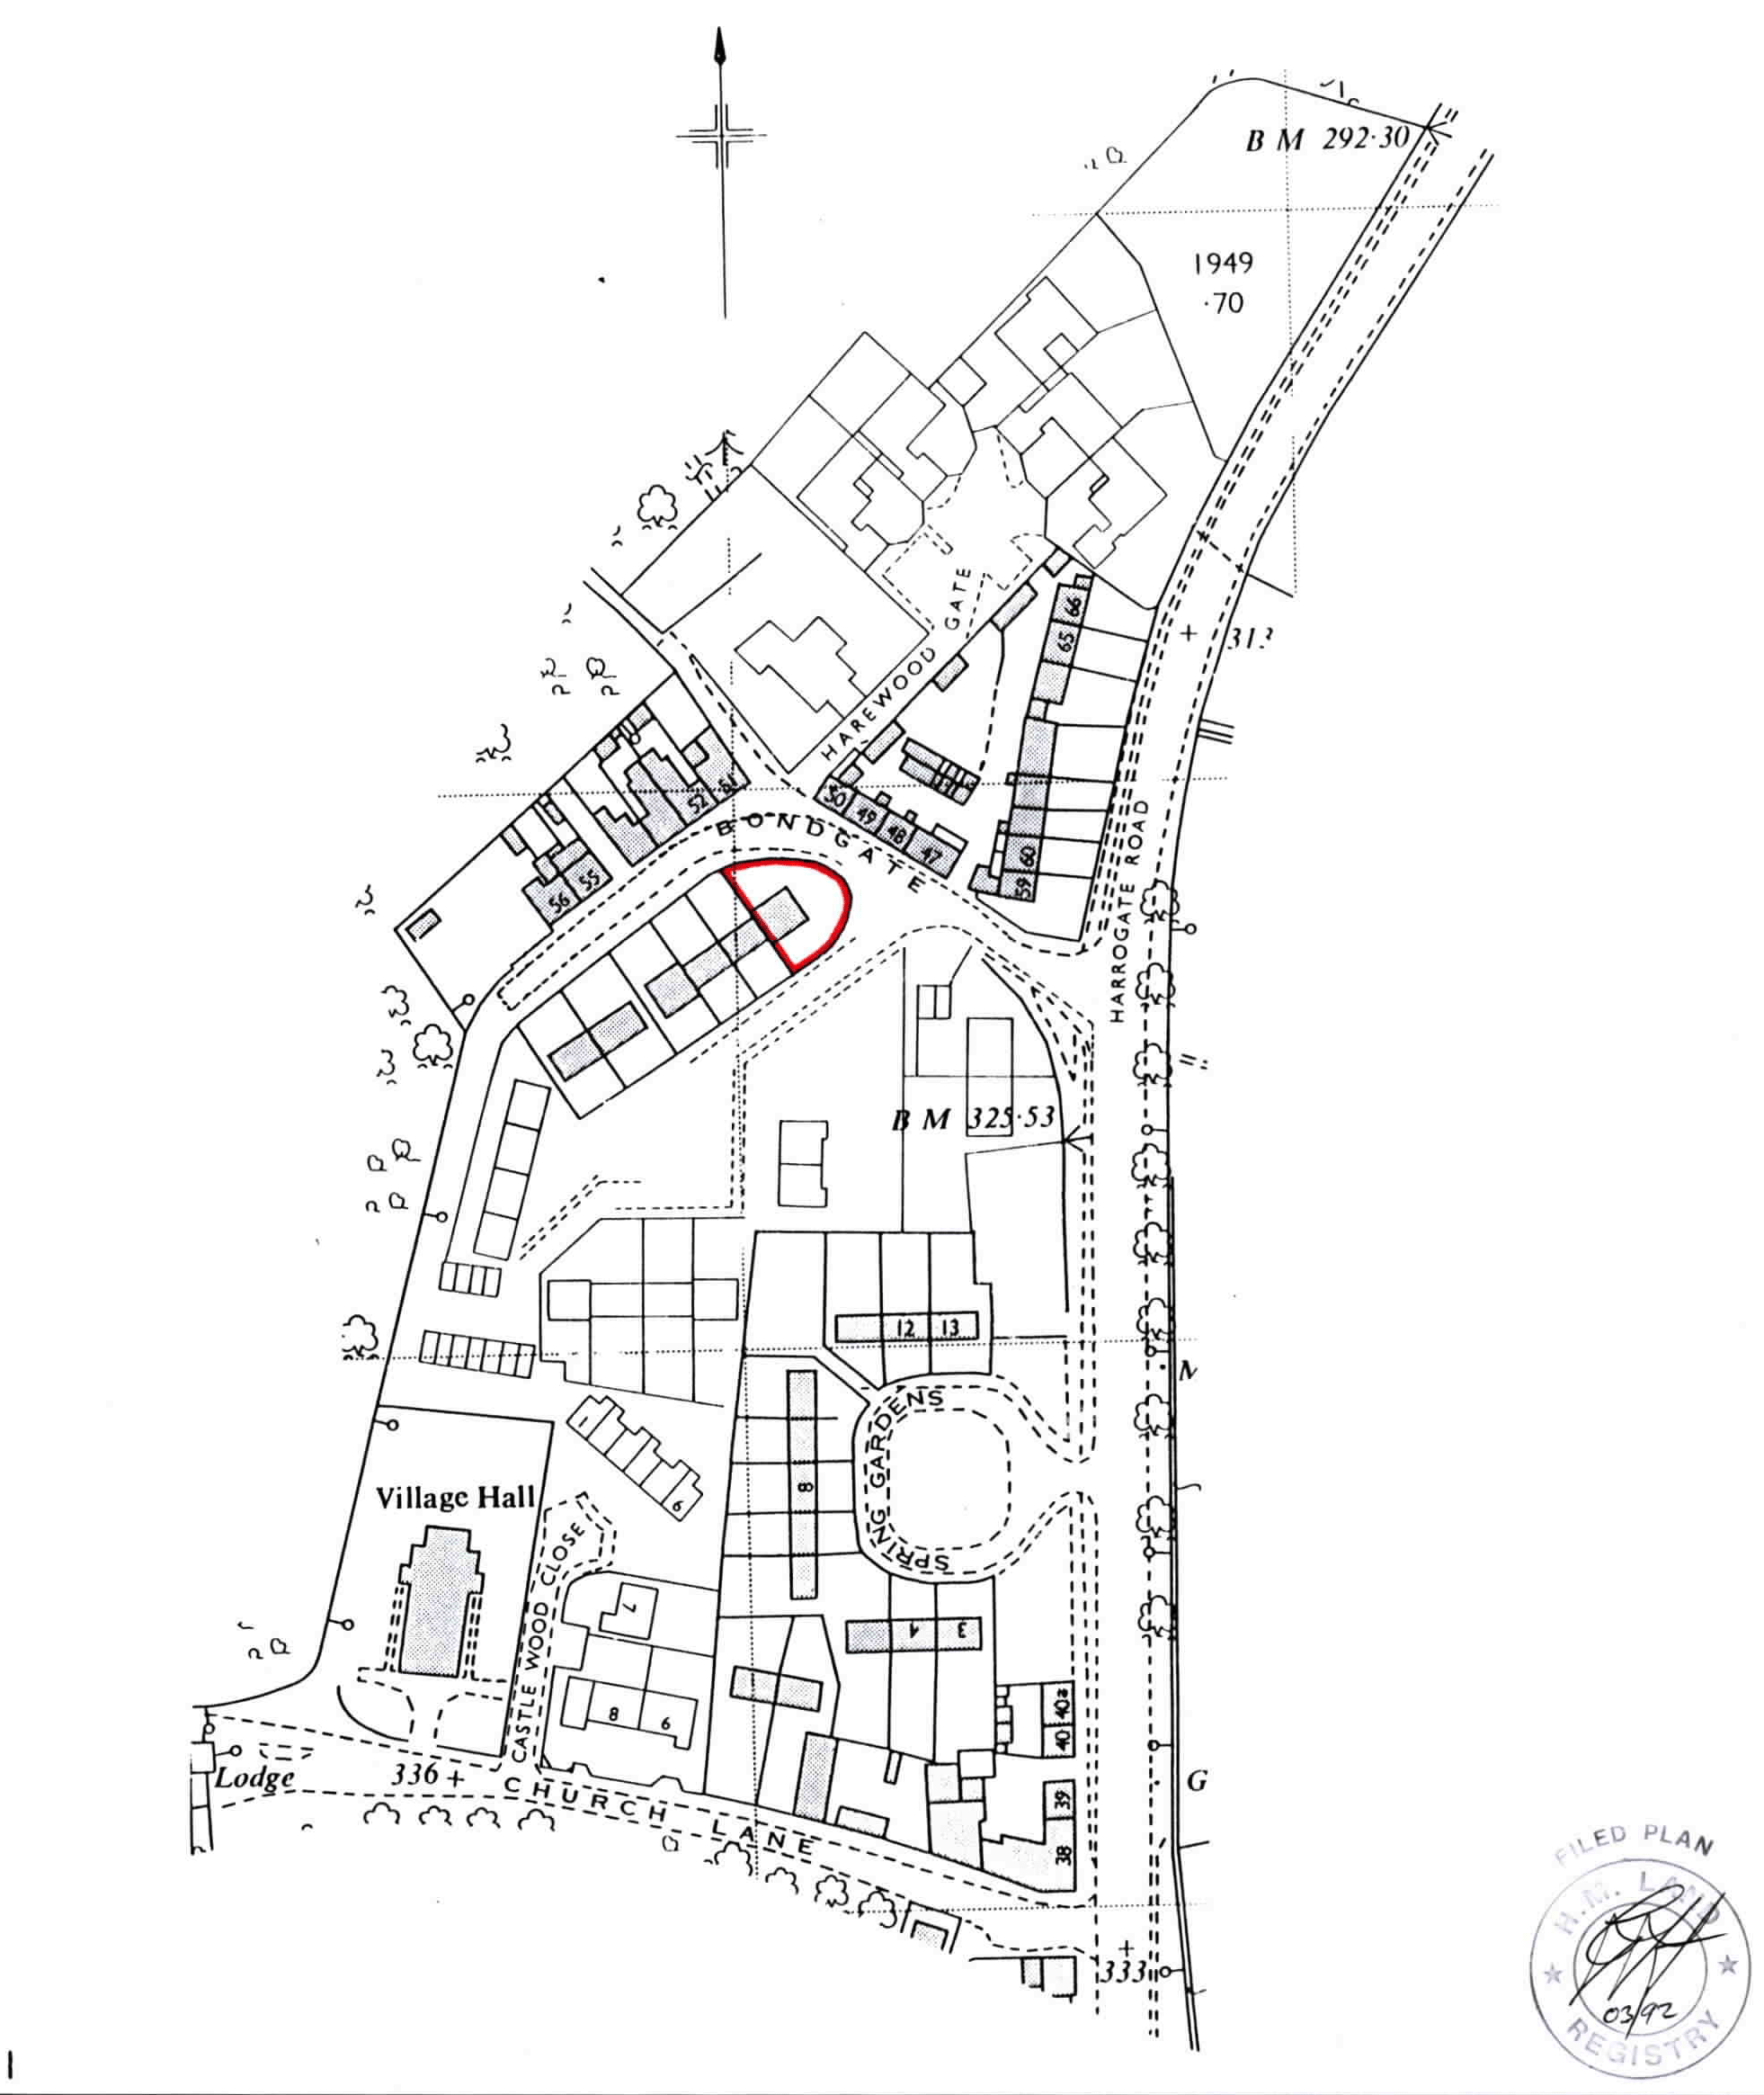
February 2024
The Complete Report
2 Bondgate, Harewood LS17 9LN

Slide 2
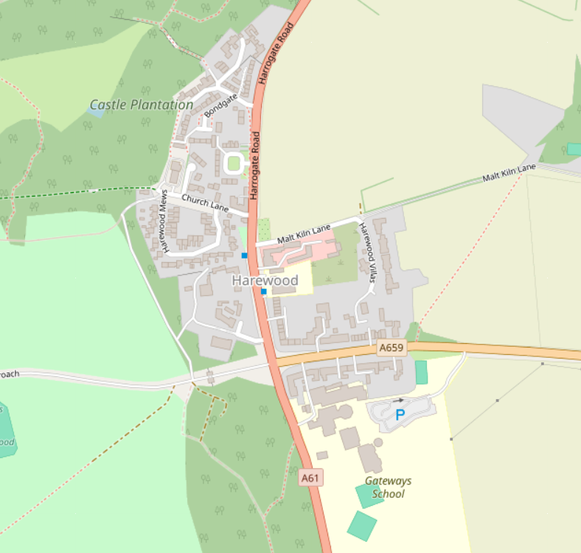
February 2024
Yorkshire Property Report has been instructed by Mrs X XXXXX to review of 2 Bondgate, Harewood LS17 9LN. This report will:
Assess whether the asking price is fair
Identify the nearest affordable house to 2 Bondgate, Harewood
Compare crime levels between 2 Bondgate, Harewood and [your current address]
MARKET VALUE
1.1
2 Bondgate was last sold on 08.02.2006 for £140,000. Using Nationwide’s house price calculator (which adjusts for location), the property would now be worth around £197,538.
1.2
We have done our own thorough review of the recent sales in Harewood. Direct comparable homes were difficult to find, and in the last 12 months, only four properties within a 0.5mile radius have sold (see below).
1
2
3
4
2

Slide 3
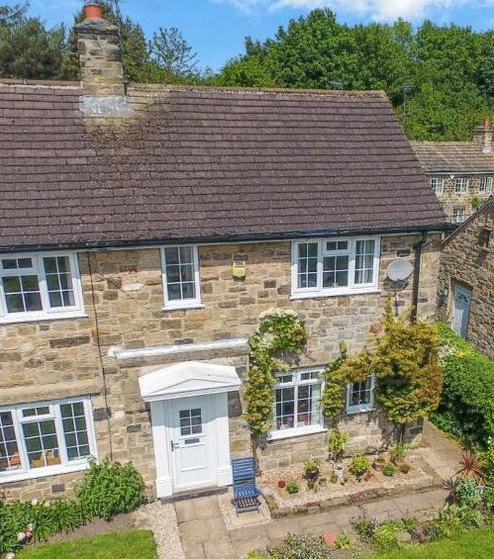
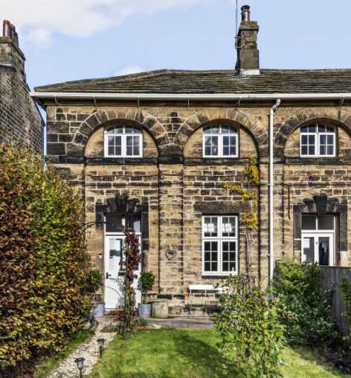
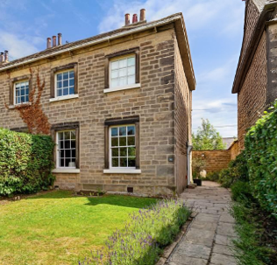
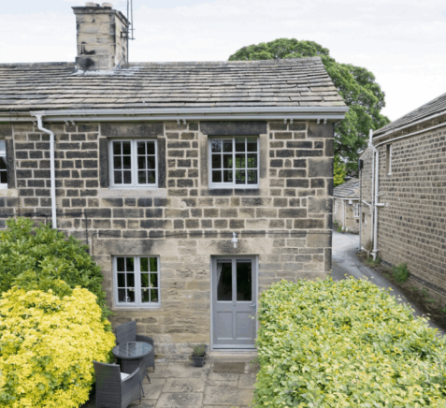
February 2024
1.
2.
Address:
Type:
Date Sold:
Sold For:
Size:
£ / Sq ft:
10 Bondgate, LS17 9LN
2B Semi Detached
12.02.24
£365,000
916 sq ft
£398.47
Address:
Type:
Date Sold:
Sold For:
Size:
£ / Sq ft:
10 The Avenue, LS17 9LD
3B End Terrace
31.05.23
£420,000
1,005 sq ft
£417.91
3.
4.
Address:
Type:
Date Sold:
Sold For:
Size:
£ / Sq ft:
91 The Avenue, LS17 9LD
4B End Terrace
28.02.24
£650,000
2,371 sq ft
£274.14
Address:
Type:
Date Sold:
Sold For:
Size:
£ / Sq ft:
28 Harrogate Road, LS17 9LH
3B End Terrace
27.03.23
£303,320
1,005 sq ft
£382.98
3

Slide 4
February 2024
1.3
Property 1 (10 Bondgate) is the best comparison available. It's the closest in size to 2 Bondgate (which is 368 sq ft) and sits on the same street.
However, the two properties aren't identical. While 2 Bondgate is smaller and will cost less overall, smaller homes typically sell for more per square foot than larger ones. This is because buyers pay a premium for entry-level homes in popular areas. Generally, smaller homes cost 10% to 30% more per square foot than larger homes of similar quality in the same location.
Based on this, a fair price for 2 Bondgate would be around £199,952.
This is well below the current asking price of £240,000. However, homes like 2 Bondgate are rare in this area, which means buyers will likely pay over the odds to secure one. With this in mind, an offer of £210,000 would be reasonable.
T U R N T O N E X T P A G E
4

Slide 5
February 2024
LOCAL CRIME LEVELS
2.1
Month | Crime Category | No. of Incidents | Location
Jan 2024 | Public Order | x1 | 1. Outside Harewood Arms Hotel
Sep 2023 | Violence & sexual offenses | x1
Nov 2023 | Violence & sexual offenses | x2 | 2. Near Gateways school
Oct 2023 | Violence & sexual offenses | x1
 | Criminal damage & arson | x1
Nov 2023 | Antisocial behaviour | x1 | 3. In front of rented property 8 Harewood Mews
 | Theft | x1
 | Criminal damage & arson | x1
Oct 2023 | Theft | x1
We looked at crime within a quarter-mile of 2 Bondgate. Between August 2023 and January 2024, there were 10 reported crimes.
The table and map show when and where each crime happened, and what type it was.
You can compare this with the crime data for your current address on the next page.
*No crimes were reported in August and December 2023.
3
1
2
5

Slide 6
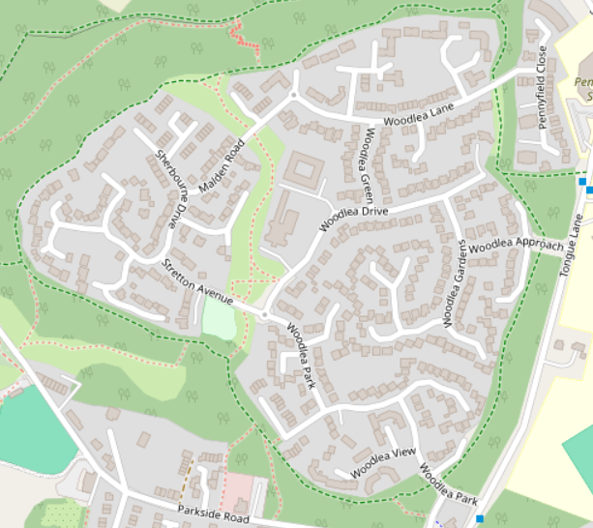
February 2024
2.2
We also looked at crime within a quarter-mile of your current address. This lets you compare the two areas to see which neighbourhood is currently safer. Over the same six months, there were 21 reported crimes near 25 Woodlea Garth.
1
3
2
Month | Crime Category | No. of Incidents | Location
Jan 2024 | Theft from person | X1 | 1.
Dec 2023 | Anti-social behaviour | X1
Aug 2023 | Violence & sexual offenses | X1
Jan 2024 | Violence & sexual offenses | X1 | 2.
 | Criminal damage & arson | X1
Nov 2023 | Burglary | X1
 | Public Order | X1
Oct 2023 | Violence & sexual offences | X1
Aug 2023 | Violence & sexual offences | X2
7
5
7
6
4
8
8
*Note: 'Other Crime' (such as forgery and perjury) has been left out of this data."
T U R N T O N E X T P A G E
6

Slide 7
February 2024
Month | Crime Category | No. of Incidents | Location
Jan 2024 | Theft from person | X1 | 1.
Dec 2023 | Anti-social behaviour | X1
Aug 2023 | Violence & sexual offenses | X1
Jan 2024 | Violence & sexual offenses | X1 | 2.
 | Criminal damage & arson | X1
Nov 2023 | Burglary | X1
 | Public Order | X1
Oct 2023 | Violence & sexual offences | X1
Aug 2023 | Violence & sexual offences | X2
Jan 2024 | Violence & sexual offenses | X1 | 3.
Sep 2023 | Vehicle Crime | X1
Aug 2023 | Public Order | X1
Dec 2023 | Robbery | X1 | 4.
Oct 2023 | Public Order | X1
Nov 2023 | Violence & sexual offenses | X1 | 5.
Oct 2023 | Violence & sexual offenses | X1 | 6.
Sep 2023 | Violence & sexual offenses | X1 | 7.
Aug 2023 | Anti-social behaviour | X1
Sep 2023 | Public order | X1 | 8.
Aug 2023 | Public order | X1
7
8
T U R N T O N E X T P A G E
7

Slide 8
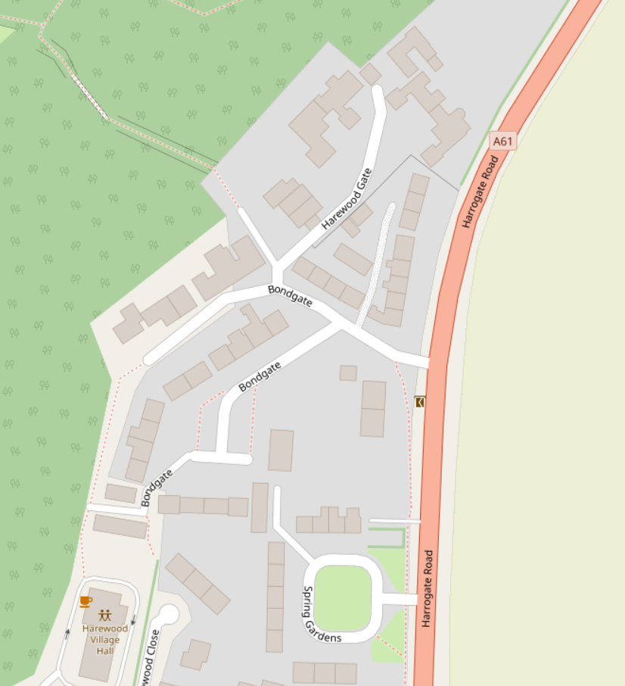
February 2024
NEAREST AFFORDABLE HOUSE
3.1
The map below shows affordable homes in the area, marked in red. The nearest one to 2 Bondgate (shown in black) is a one-bedroom bungalow just two doors down, about 17 metres to the southwest. It is owned by Leeds City Council.
E N D O F R E P O R T
8

